Slide 1
IBM University Engagement Project Submission
“Exploring the Power of Agentic AI with IBM Granite and LangFlow”

Slide 2

Project Title – [Agentic AI without using IBM bob]
Domain of Project – [Factors related to College Admission Process ]
Student Name | Recent Passport Photo | Email ID | Mobile number [WhatsApp]
Shreyash Dubey |  | shreyashdubey2007@gmail.com | 9028843967

Slide 3
Problem Statement -
Problem Statement No.4 - College Admission Agent ( RAG Based ) The Challenge - A College Admission Agent, powered by RAG (Retrieval-Augmented Generation), streamlines the student admission process. It retrieves and summarizes admission policies, eligibility criteria, and FAQs from institutional databases and official sources. Prospective students can ask natural language questions and receive accurate, up-to-date responses instantly. The agent helps with course selection, application guidance, fee structure, and important deadlines. Using trusted, real-time data, it reduces manual inquiries and enhances applicant experience . This AI-driven assistant boosts transparency, accessibility, and efficiency in college admissions.

Slide 4
Proposed Solution -
The proposed solution is a Retrieval-Augmented Generation (RAG) chatbot built using IBM watsonx.ai and LangChain . Instead of relying solely on a language model, the chatbot first searches a vector database created from the uploaded PDF. The retrieved information is then provided to the Llama 3.3 model, which generates an accurate and context-aware response. This approach minimizes hallucinations and ensures responses remain relevant to the uploaded knowledge base. this project is to develop an AI-based chatbot that provides instant and reliable answers to students' admission-related queries. The chatbot retrieves relevant information from an official college guide PDF instead of generating random responses. It aims to reduce students' effort, improve accessibility to admission information, and provide a user-friendly interface that can be accessed from anywhere.

Slide 5
Technology Used :
Streamlit – Used to build the interactive web interface for the chatbot. It provides a simple, responsive, and user-friendly platform where students can ask admission-related questions and receive AI-generated answers in real time.
IBM watsonx.ai (Meta Llama 3.3) – Used as the Large Language Model (LLM) for generating intelligent, context-aware responses. The Meta Llama 3.3 model understands user queries and produces detailed answers using the retrieved information.
IBM Cloud – Provides the cloud infrastructure for hosting and managing the AI model securely. It ensures reliable, scalable, and high-performance execution of the chatbot application.
LangChain – Acts as the orchestration framework that connects the language model with the vector database. It manages document retrieval, prompt construction, and response generation efficiently.
Retrieval-Augmented Generation (RAG) – Enhances the chatbot by retrieving relevant information from the uploaded college admission guide before generating a response. This improves accuracy, reduces hallucinations, and ensures answers are based on the provided document.
FAISS Vector Database – Stores embeddings of the admission guide for efficient semantic search. It quickly retrieves the most relevant document chunks corresponding to the user's query.
Hugging Face Embeddings (all-MiniLM-L6-v2) – Converts the PDF content into dense vector embeddings that capture semantic meaning, enabling accurate similarity search within the FAISS database.
PyPDFLoader – Extracts text from the college admission PDF document. It converts the uploaded guide into a format suitable for preprocessing and vectorization.
Recursive Character Text Splitter – Divides the PDF into smaller overlapping chunks while preserving context. This improves retrieval quality and allows the language model to generate more precise responses.

Slide 6
Langflow component Used -
Chat Input – Accepts user queries related to college admissions, such as eligibility, fees, cutoffs, placements, and college comparisons through the Streamlit chat interface.
IBM watsonx.ai Agent – Processes the retrieved context and user query using the Meta Llama 3.3 model to generate accurate, context-aware admission guidance.
IBM Granite Model (Meta Llama 3.3 Model) – The Large Language Model used for understanding user questions, reasoning over the retrieved information, and generating detailed natural language responses.
RAG (Retrieval-Augmented Generation) – Retrieves the most relevant information from the FAISS Vector Database before sending it to the LLM, ensuring responses are based on the uploaded admission guide.
File Component (College Admission PDF) – Stores the uploaded college admission guide containing details such as eligibility, fees, cutoffs, placements, admission process, and scholarships. This document acts as the chatbot's knowledge base.

Slide 7
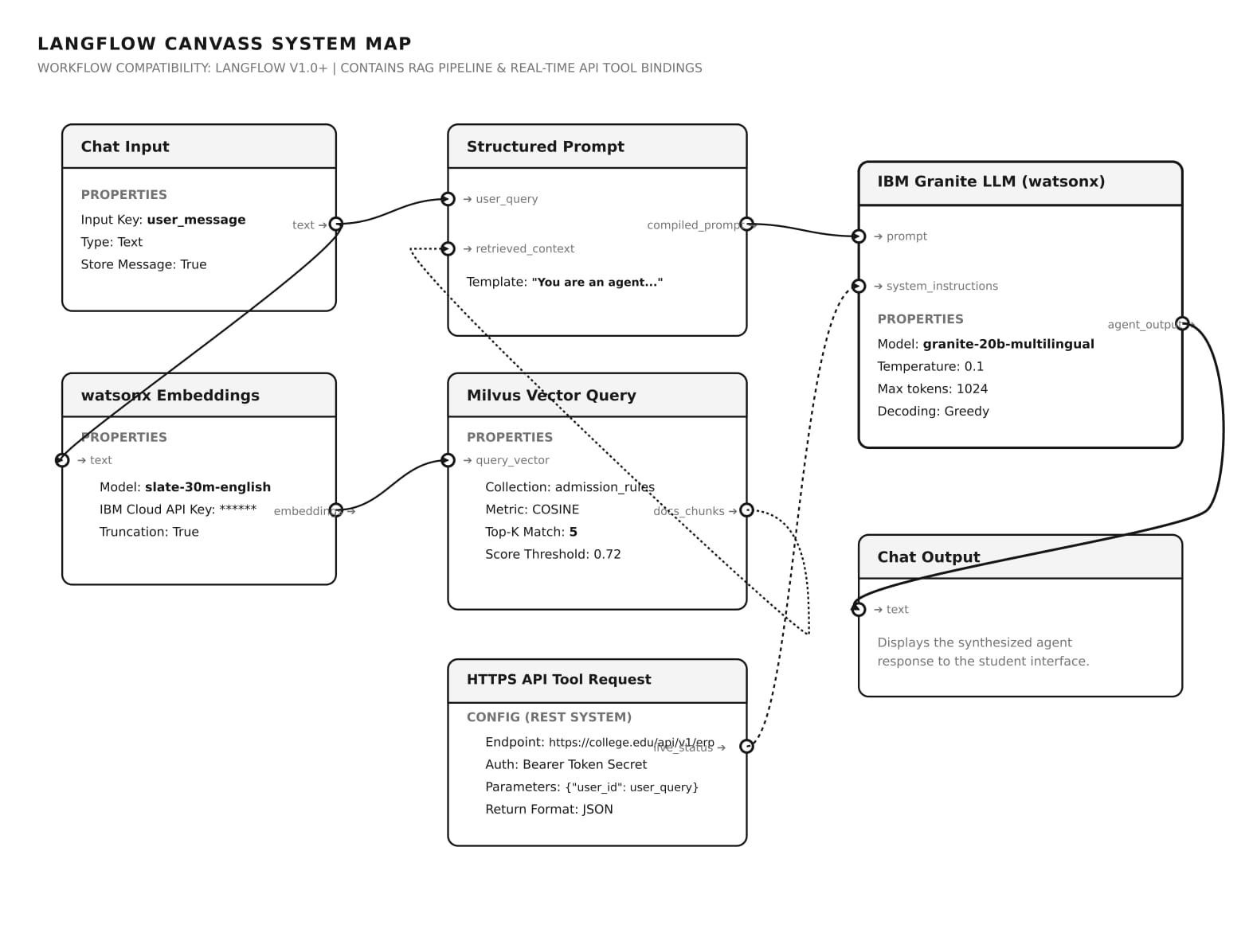
Langflow workflow -

Slide 8
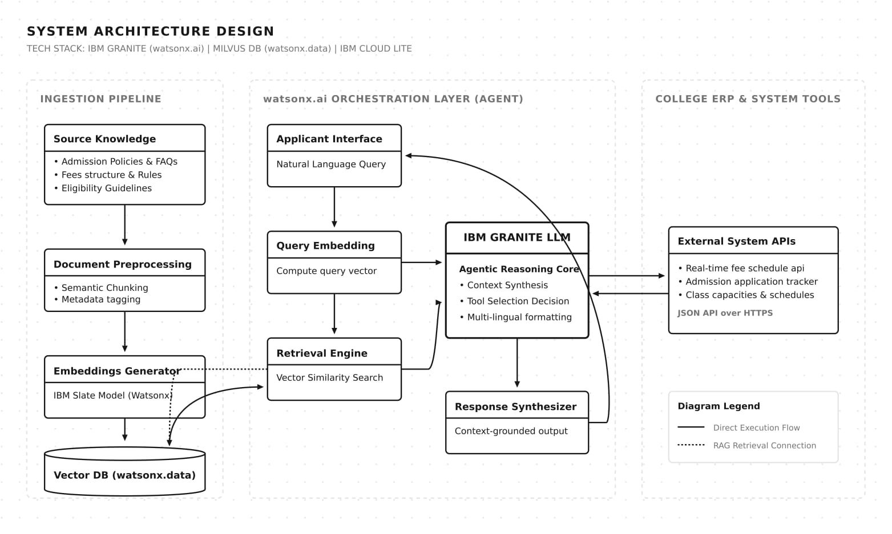
Architecture blueprint

Slide 9
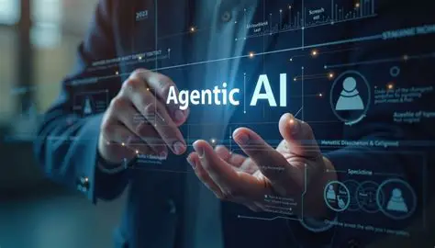
Role of Agentic AI in the solution
Understands User Intent :The Agentic AI first analyzes the user's question to understand what information is being requested. It identifies whether the query is about admissions, cutoffs, fees, placements, eligibility, or another college-related topic. This helps the chatbot provide relevant and accurate responses.
Retrieves Relevant Information :Instead of generating answers from memory, the agent searches the FAISS vector database created from the uploaded college PDF. It retrieves the most relevant document chunks using Retrieval-Augmented Generation (RAG). This ensures responses are based on the actual knowledge base.
Generates Context-Aware Responses :The retrieved information is combined with the user's question and sent to the Llama 3.3 model on IBM watsonx.ai. The AI generates clear, detailed, and easy-to-understand answers. It avoids hallucinations by relying on the retrieved context.
Handles Different Types of Queries :The agent can answer questions related to admissions, fee structure, eligibility criteria, placements, scholarships, hostel facilities, and cutoffs. It adapts its response based on the type of query asked by the user. This makes the chatbot more intelligent and user-friendly.
Improves User Experience: The Agentic AI provides quick, interactive, and personalized responses through the Streamlit interface. It reduces the time required to search through lengthy college documents. Students receive accurate information in a conversational format, making the admission process simpler and more efficient.

Slide 10
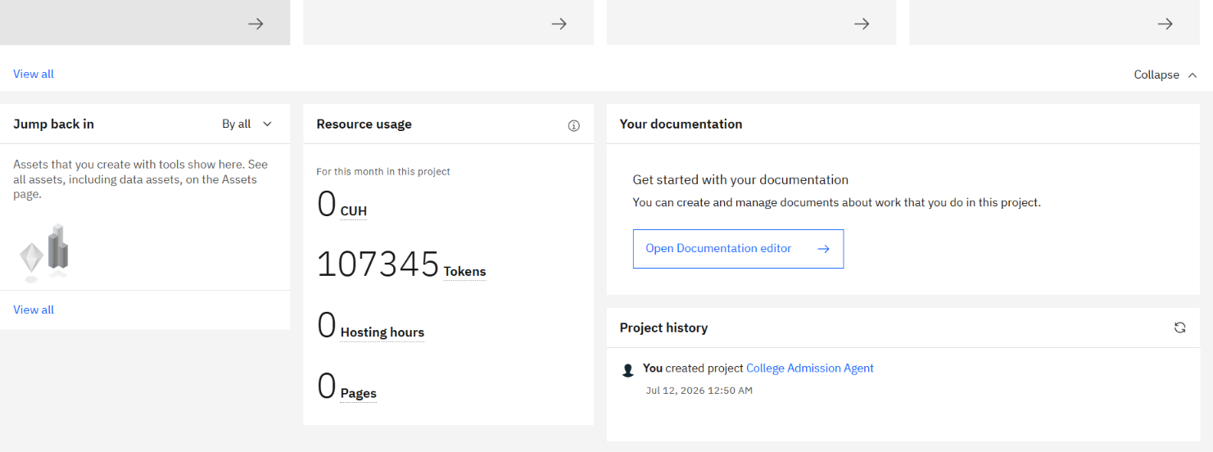
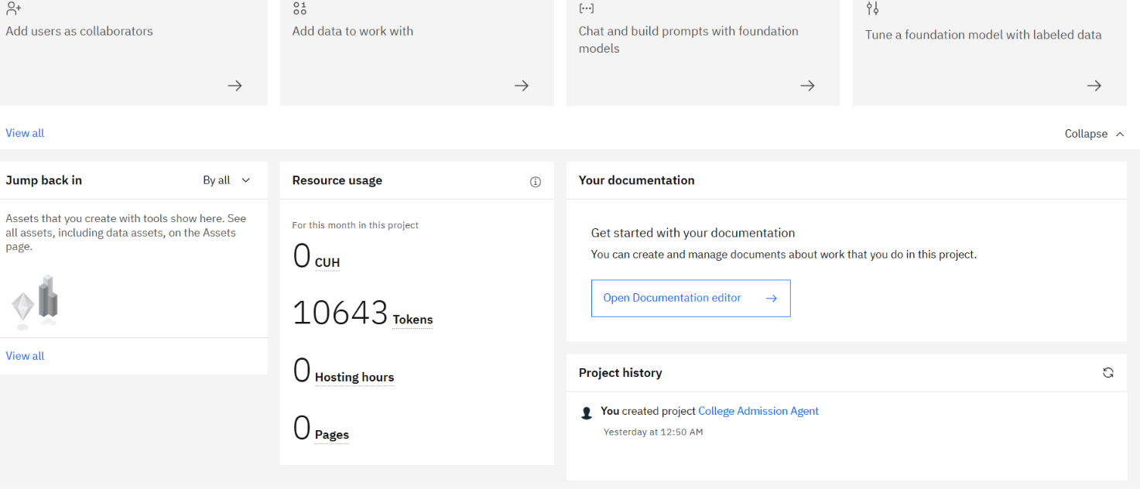
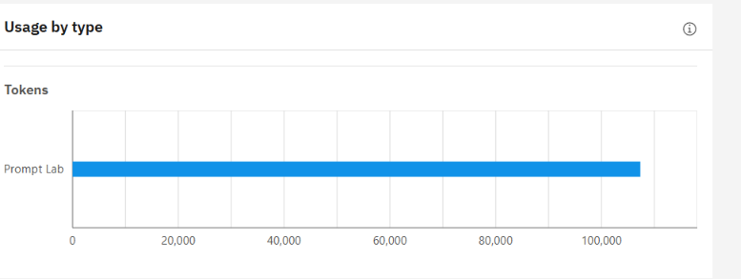
Token Usage : Total 107345 Tokens are used.
·
·
·

Slide 11
Novelty and Uniqueness
Novelty
AI-Powered College Admission Assistant
Uses IBM watsonx.ai with the Llama 3.3 model to answer admission-related queries in natural language instead of using fixed FAQs.
RAG-Based Information Retrieval
Combines Retrieval-Augmented Generation (RAG) with a FAISS vector database to retrieve relevant information from uploaded college PDFs before generating responses.
Semantic Search Capability
Finds relevant information based on the meaning of the user's query rather than exact keyword matching, resulting in more accurate answers.
Uniqueness
Dynamic Knowledge Base
The chatbot can be updated by simply adding new college PDFs and rebuilding the vector database without changing the application code.
End-to-End AI Solution
Integrates PDF processing, embeddings, vector search, IBM watsonx.ai, and a Streamlit interface into one complete admission assistance system.
Student-Centric Conversational Experience
Provides instant, detailed, and context-aware responses about admissions, fees, cutoffs, eligibility, placements, and scholarships through an easy-to-use chat interface, reducing the need to manually search lengthy documents.

Slide 12
Git Hub Link :https://github.com/Shreythemasterai/college-admission-chatbot.git
Chatbot Link through Streamlite App : https://college-admission-chatbot-nndncs28ay45botepsg59w.streamlit.app/
Project Workflow
Step 1 – Upload Knowledge Base
The admission guide PDF is uploaded into the project. This document acts as the chatbot's primary knowledge source and contains information about colleges, fees, placements, eligibility, scholarships, and admission procedures.
Step 2 – Document Processing
The uploaded PDF is processed using PyPDFLoader and divided into manageable chunks using RecursiveCharacterTextSplitter. This ensures that large documents can be efficiently searched and understood.
Step 3 – Embedding Generation
Each text chunk is converted into vector embeddings using Hugging Face's sentence-transformer model. These embeddings capture the semantic meaning of the content instead of relying only on keyword matching.
Step 4 – Vector Database Creation
The generated embeddings are stored in a FAISS vector database. This database enables fast similarity searches, allowing the chatbot to retrieve the most relevant information for any user query.
Step 5 – Response Generation
When a user asks a question, the chatbot retrieves the most relevant document chunks from FAISS. These chunks are passed to IBM watsonx.ai's Llama 3.3 model, which generates a detailed and context-aware answer.·
·

Slide 13
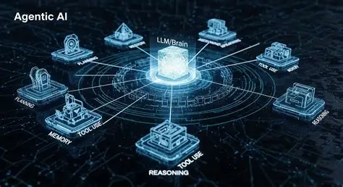
Future Scope
The chatbot can be enhanced by integrating multiple college PDFs instead of relying on a single document. Features such as voice interaction, multilingual support, personalized college recommendations based on entrance exam scores, and integration with live admission portals can make the system more powerful. Future versions can also incorporate advanced Agentic AI capabilities to automate admission guidance and document verification.
·
·
·

Slide 14
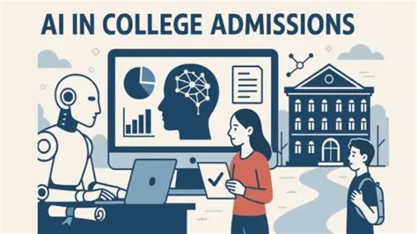
Conclusion The AI-Powered College Admission Assistant demonstrates how Retrieval-Augmented Generation and IBM watsonx.ai can simplify the college admission process. By combining semantic search with a Large Language Model, the chatbot delivers accurate, context-aware, and reliable responses. The project showcases the practical application of Agentic AI in education and highlights the potential of intelligent assistants to improve access to information while reducing manual effort.

Slide 15
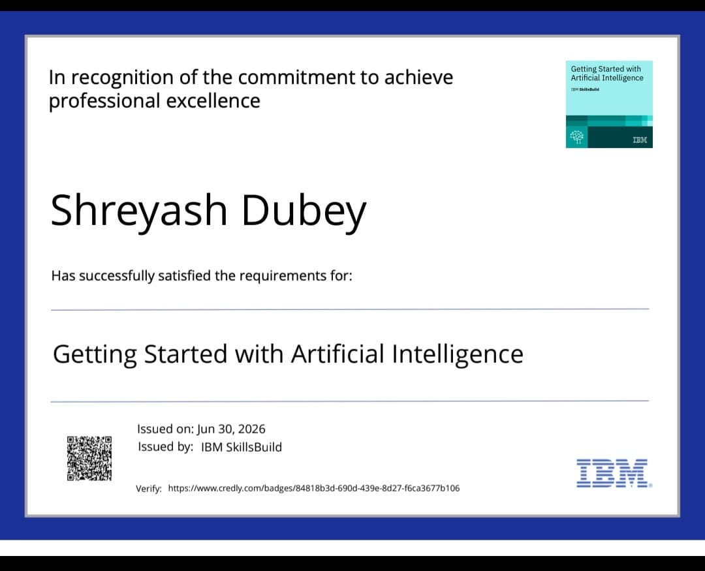
Certificates Earned:
Getting Started with Artificial Intelligence

Slide 16
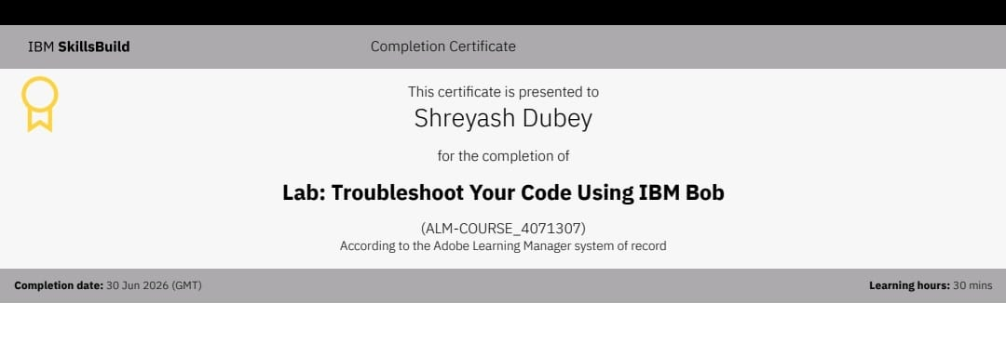
Certificates Earned:​
IBM BOB Certificate

Slide 17
THANK YOU

